Slide 1
Networks Part 2: Infrastructure + Protocols

Slide 2
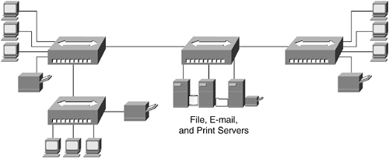
DEFINITION
LAN (Local Area Network)
Devices connected inside an office, building or small geographic area of an organization for LOCAL sharing of resources such as files, printers, applications, etc.
A LAN can be just two connected computers or can be thousands of connected devices.
Key features
Limited geographic area
Share a common IP address numbering range
Notes:
All local area networks must have the same IP address numbering range. On a simple level, this means they “start” with the same series. For example, 192.168.1.3 and 192.168.1.6 belong to the same network. However, this is true only if they both have a subnet mask of 255.255.255.0.
Subnet masks are a complicated topic, but very simplistically → the part of the subnet mask that has 255 determines which part of the IP address represents the network portion of the IP address. An IP address of 10.3.5.6 with a subnet mask of 255.0.0.0 and an IP address of 10.16. 24.9 with a subnet mask of 255.0.0.0 – these two devices are in the same network.
Note: it REALLY is not that simple, but it can be eyeballed that way for a lot of cases.

Slide 3
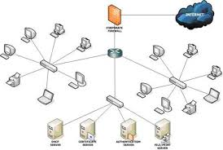
DEFINITION
WAN (Wide Area Network)
Devices connected across a wide area.
Usually a collection of connected LANs
The INTERNET is the largest WAN and is represented graphically as a cloud

Slide 4
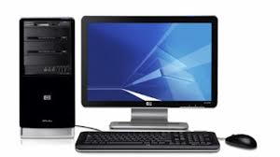
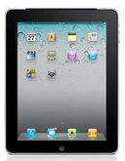




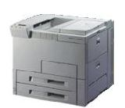
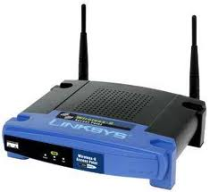
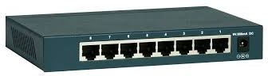
Network Hardware
What hardware does it take to deliver data?
Hosts - PCs, servers, network printers, tablets, mobile phones, etc.
LAN central connection devices - Hub, switch
Notes:
Hub - a hub is a place of convergence where data arrives from one or more directions and is forwarded out in one or more other directions. A hub usually includes a switch of some kind.
Switch - a switch is a device that channels incoming data from any of multiple input ports to the specific output port that will take the data toward its intended destination.
WAP -

Slide 5
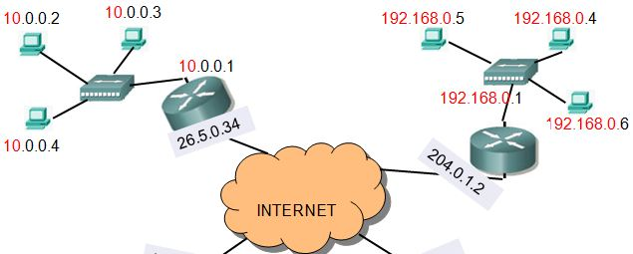
Network Hardware
WAN Central Connection Device - Router (a.k.a “default gateway”) A router is the only device that can connect two networks together. AKA “default gateway” Whenever a host joins a network it gets an IP address.
If the host wants to send data to a host in another network, it needs a router.
Router
Router
Notes:
Aka “default gateway” – the router is the way out of the network . When a packet is sent with a destination IP address that is outside of the local network, it is automatically sent to the IP address of the “default gateway” – i.e. the router responsible for our LAN. All IP address configurations on devices must have a setting for the default gateway so that there is somewhere to go for unknown addresses.

Slide 6
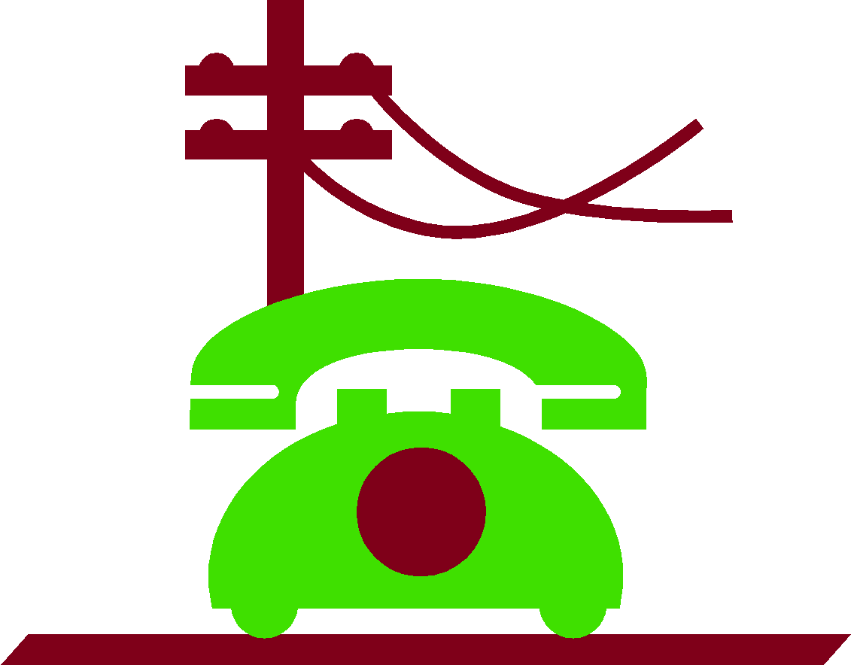
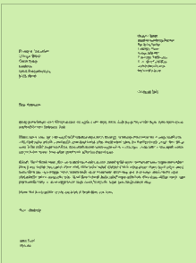
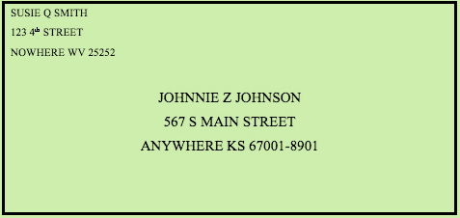
Digital Packets
Older forms of communication like analog telephone calls send the signal across a single direct connection.
Analogy: a letter
The entire message is written and then sent in one envelope. The reader receives the letter, opens the envelope and reads the message from beginning to end.
Notes:
Packets use IP, to make sure the message reaches the right person

Slide 7
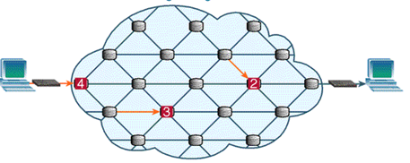

Digital Packets
Digital communications instead break up the signal into pieces and send them on different paths.
Analogy: a set of postcards
The message is broken up into parts – each part is written on a separate postcard. The postcards are numbered.
Each postcard could take a different route to get to the receiver. They will probably arrive out of order.
When the receiver gets the postcards, he uses the numbers to put them in order and to figure out if all of them have been received. THEN he can read the entire message.
Part 1 of 3
Having a great
time. The weather
Part 2 of 3
is fine. I am running out of money - could
Part 3 of 3
you send me a check?
Love – your son
Mom
1 Main St
USA
Mom
1 Main St
USA
Mom
1 Main St
USA
Notes:
Click for larger image of routing packets

Slide 8
Protocols
To deliver packets in a network, there are rules that govern how data will be transmitted.
These rules are called protocols and the largest, most important set of protocols is the TCP/IP suite.
TCP/IP is a set of over 100 protocols that each determine the rules for how a TYPE of data will be exchanged between two computers.
It is named after TCP and IP which are the main protocols that do most of the heavy lifting and network communicating.

Slide 9
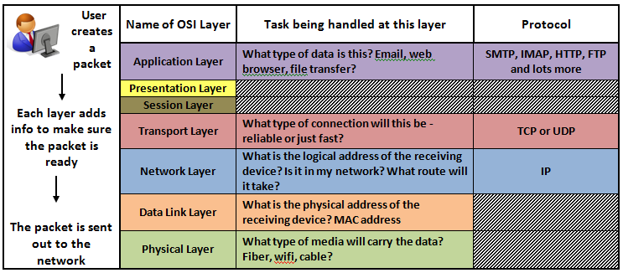
OSI Model
(open system interconnection)
Protocols handle different parts of the packet delivery. The protocols are stacked in layers, with the ones at the bottom doing the most basic tasks and the ones at the top doing the most specialized tasks.
Notes:
These are known as the OSI Layers which is made up of 7 levels, each of which has detailed specifications for packet transmission. The OSI Layers going from the bottom are: Physical, Data Link, Network, Transport, Session, Presentation and Application. Every protocol exists at one of these layers.

Slide 10
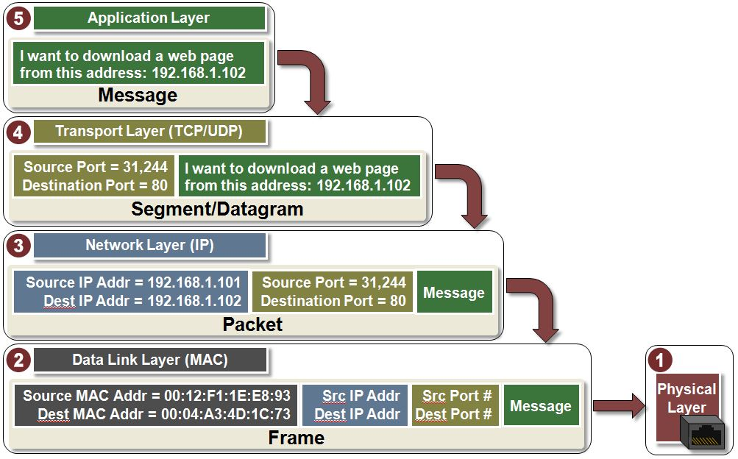
Notes:
https://www.youtube.com/watch?v=VGGmBhARuiY

Slide 11
Protocols & Ports
Most protocols are associated with a specific port number.
The port number indicates to the computer which application should handle the incoming data.
Ports are similar to doors – they are openings to handle a specific type of packet.
Example: a web browser uses the HTTP protocol which usually uses Port 80. This port is not mandatory, but a website that is NOT listening on Port 80 will have to let each user know the custom port that is being used.
My Network
HTTP
80
SMTP
25
DNS
53
IMAP
143
Notes:
Firewalls are often set to reject packets on certain ports. For instance, if you are not running a website in your network then you would close port 80 as there is no reason for anyone to be coming into the network through that port.

Slide 12



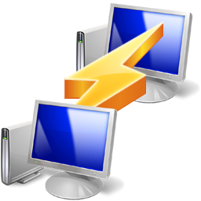
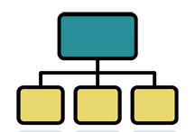
Well Known Protocols and Ports
File Transfer
FTP – 20 (data) & 21 (control)
SFTP – 115
Remote connection
SSH – 22
Telnet – 23
Network Management
DNS – 53
DHCP – 67
Mail
SMTP – 25
POP3 – 110
IMAP – 143
Web Browsing
HTTP – 80
SSL (HTTPS) – 443
After the Application layer makes the basic packet, it is sent down the stack.
At the Transport Layer there is a choice to be made -- TCP or UDP

Slide 13

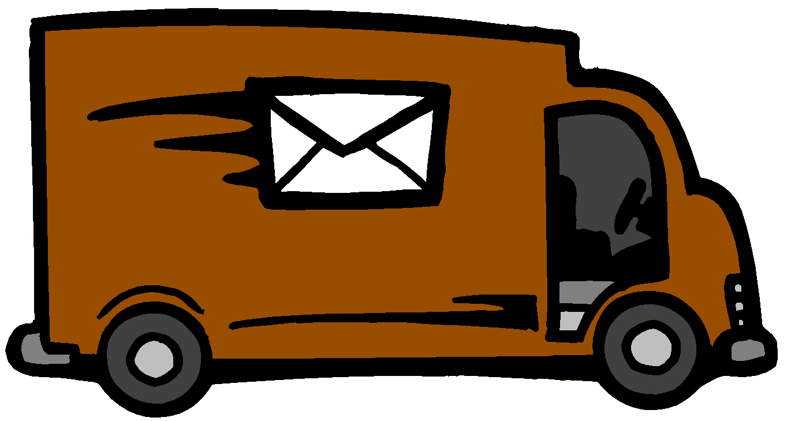
TCP vs UDP - Two carrier protocols that provide transport from the source host to the destination host.
UDP (User Datagram Protocol) – Connectionless
It doesn’t check to see if the message arrives
TCP (Transmission Control Protocol)
UDP and TCP both do 2 jobs:
Handle getting the connection started from host to host
Send segments from host to host
BUT they are different in how they handle RELIABILITY
Notes:
The user doesn’t get to choose whether the packet uses TCP or UDP – that is determined by the application layer protocol selected. For instance, HTTP is a connection oriented protocol so it uses TCP. That means that if part of the website you are trying to browse isn’t getting to your computer, then there will be error messages so that the missing packets can be resent. On the other hand, TFTP is a connectionless protocol that is meant for speedy transfer of files without caring if there are errors.

Slide 14
BUT they are different in how they handle RELIABILITY
Which one is more reliable? and why?
TCP
UDP
TCP (Transmission Control Protocol) – Connection oriented It will make sure the message gets there.
Keeps checking the connection
Sends error messages if there are packets missing

Slide 15

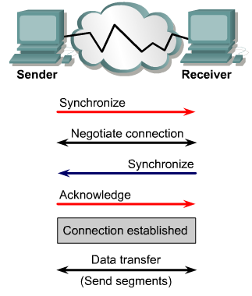
TCP – connection-oriented
3-Way Handshake To establish a synchronized source-to-destination connection between two PCs
SYN
SYN/ACK
ACK
Notes:
Sender requests synchronization
Two messages: one to acknowledge the request, second to give information about how I like to connect [connection parameters]
Acknowledgement from source to tell destination that “yes, we definitely have a connection – let’s start sharing data”
At the end of data transfer, the sending host sends a signal that indicates the end of the transmission. The receiving host at the end of the data sequence acknowledges the end of transmission and the connection is terminated.

